Slide 1
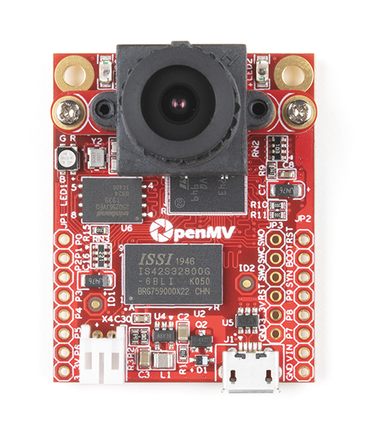
OpenMV H7 Plus
Low power camera module with on-board STM32 M7 cortex MCU which allows us to implement applications using machine vision in the real world.

Slide 2
Edge Impulse Leading development platform for machine learning on edge devices
Acquire Data Capture data from the openMV camera module using the OpenMV IDE and upload images to Edge Impulse | Design an Impulse This stage teaches the model to interpret previously unseen data, based on historical data. Use transfer learning on processed data. | Deploy Create a library of optimized source code for C++ or Arduino Applications. Also builds firmware, a ready-to-go binary for the OpenMV which contains labeled data and a TensorFlow Lite model

Slide 3
Stats
Training set contained 131 96x96 images
“Ball” and “Unknown” output features – labels
Transfer learning (no NN Keras or Regression Keras)
Color depth – RGB
100 training cycles
0.0005 learning rate
Data augmentation (takes 30 images and cuts and reverses them into 1000s of images to train with)
Minimum confidence rating : 0.8
MobileNetV2 0.05 pre-trained multi-layer CNN for classifying images.
Accuracy 89.5%
Loss 0.32
On device inference time 495ms
Peak RAM usage 925.5K
ROM usage 259.9K
Rolling shutter camera
7 fps

Slide 4
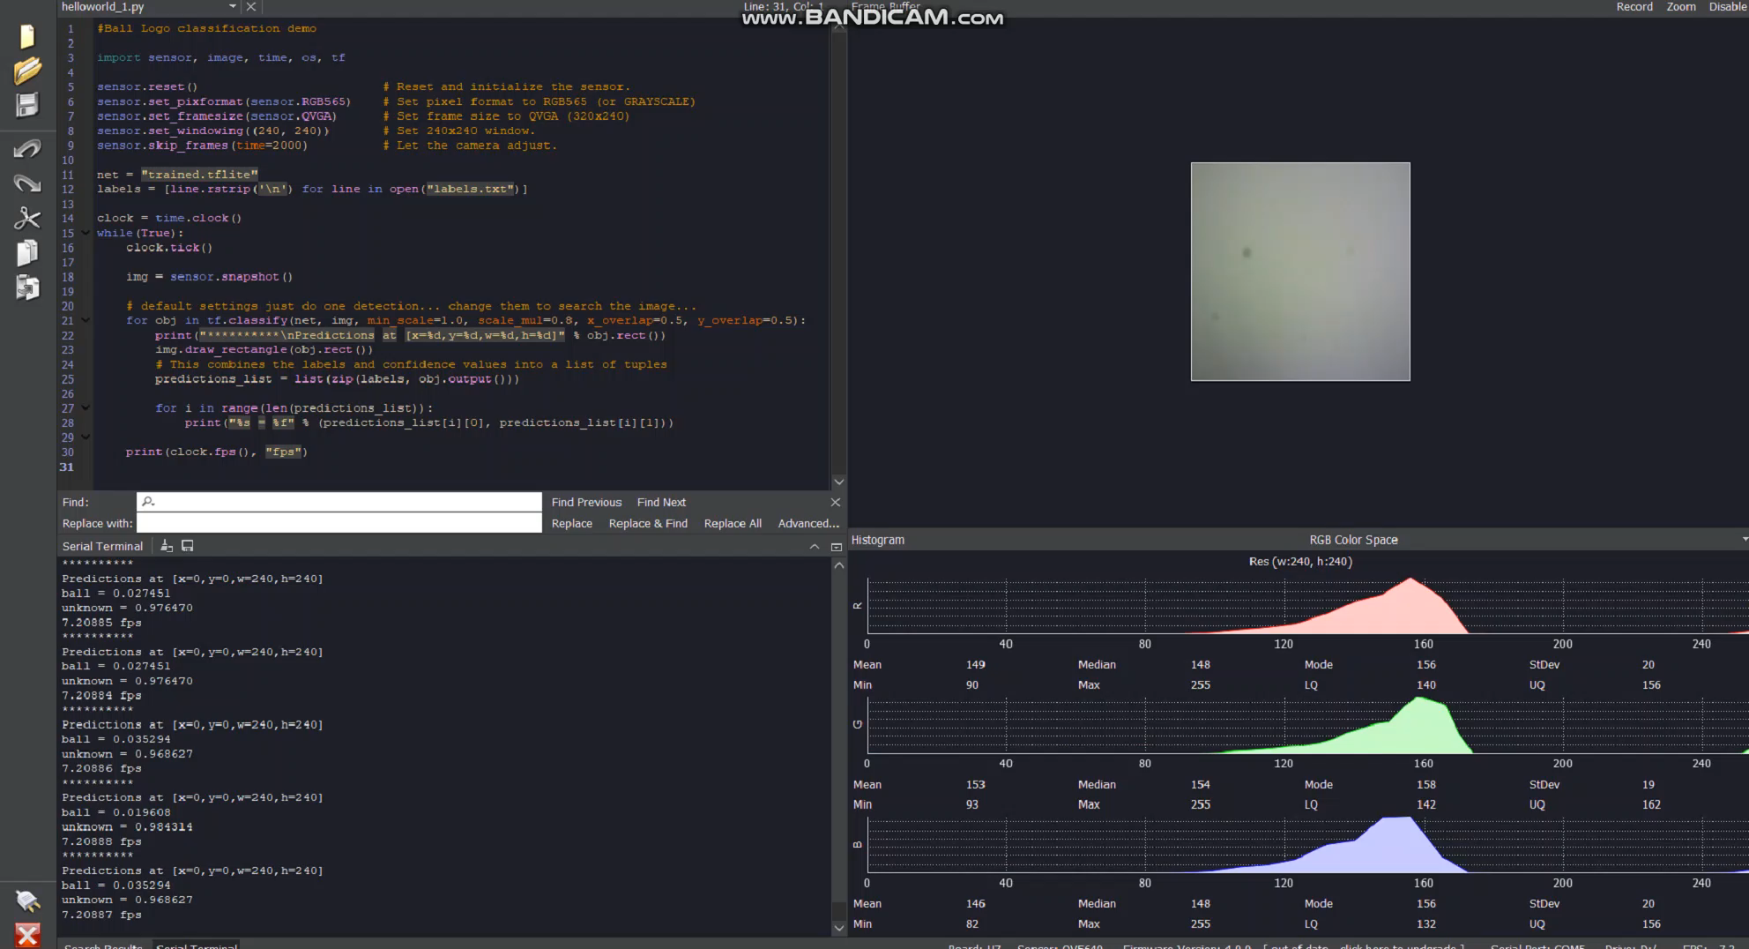
DEMO
Ball = 1
Success!

